Slide 1
Introduction to Robotics CSE461
Utsha Kumar Roy
BRAC University

Slide 2
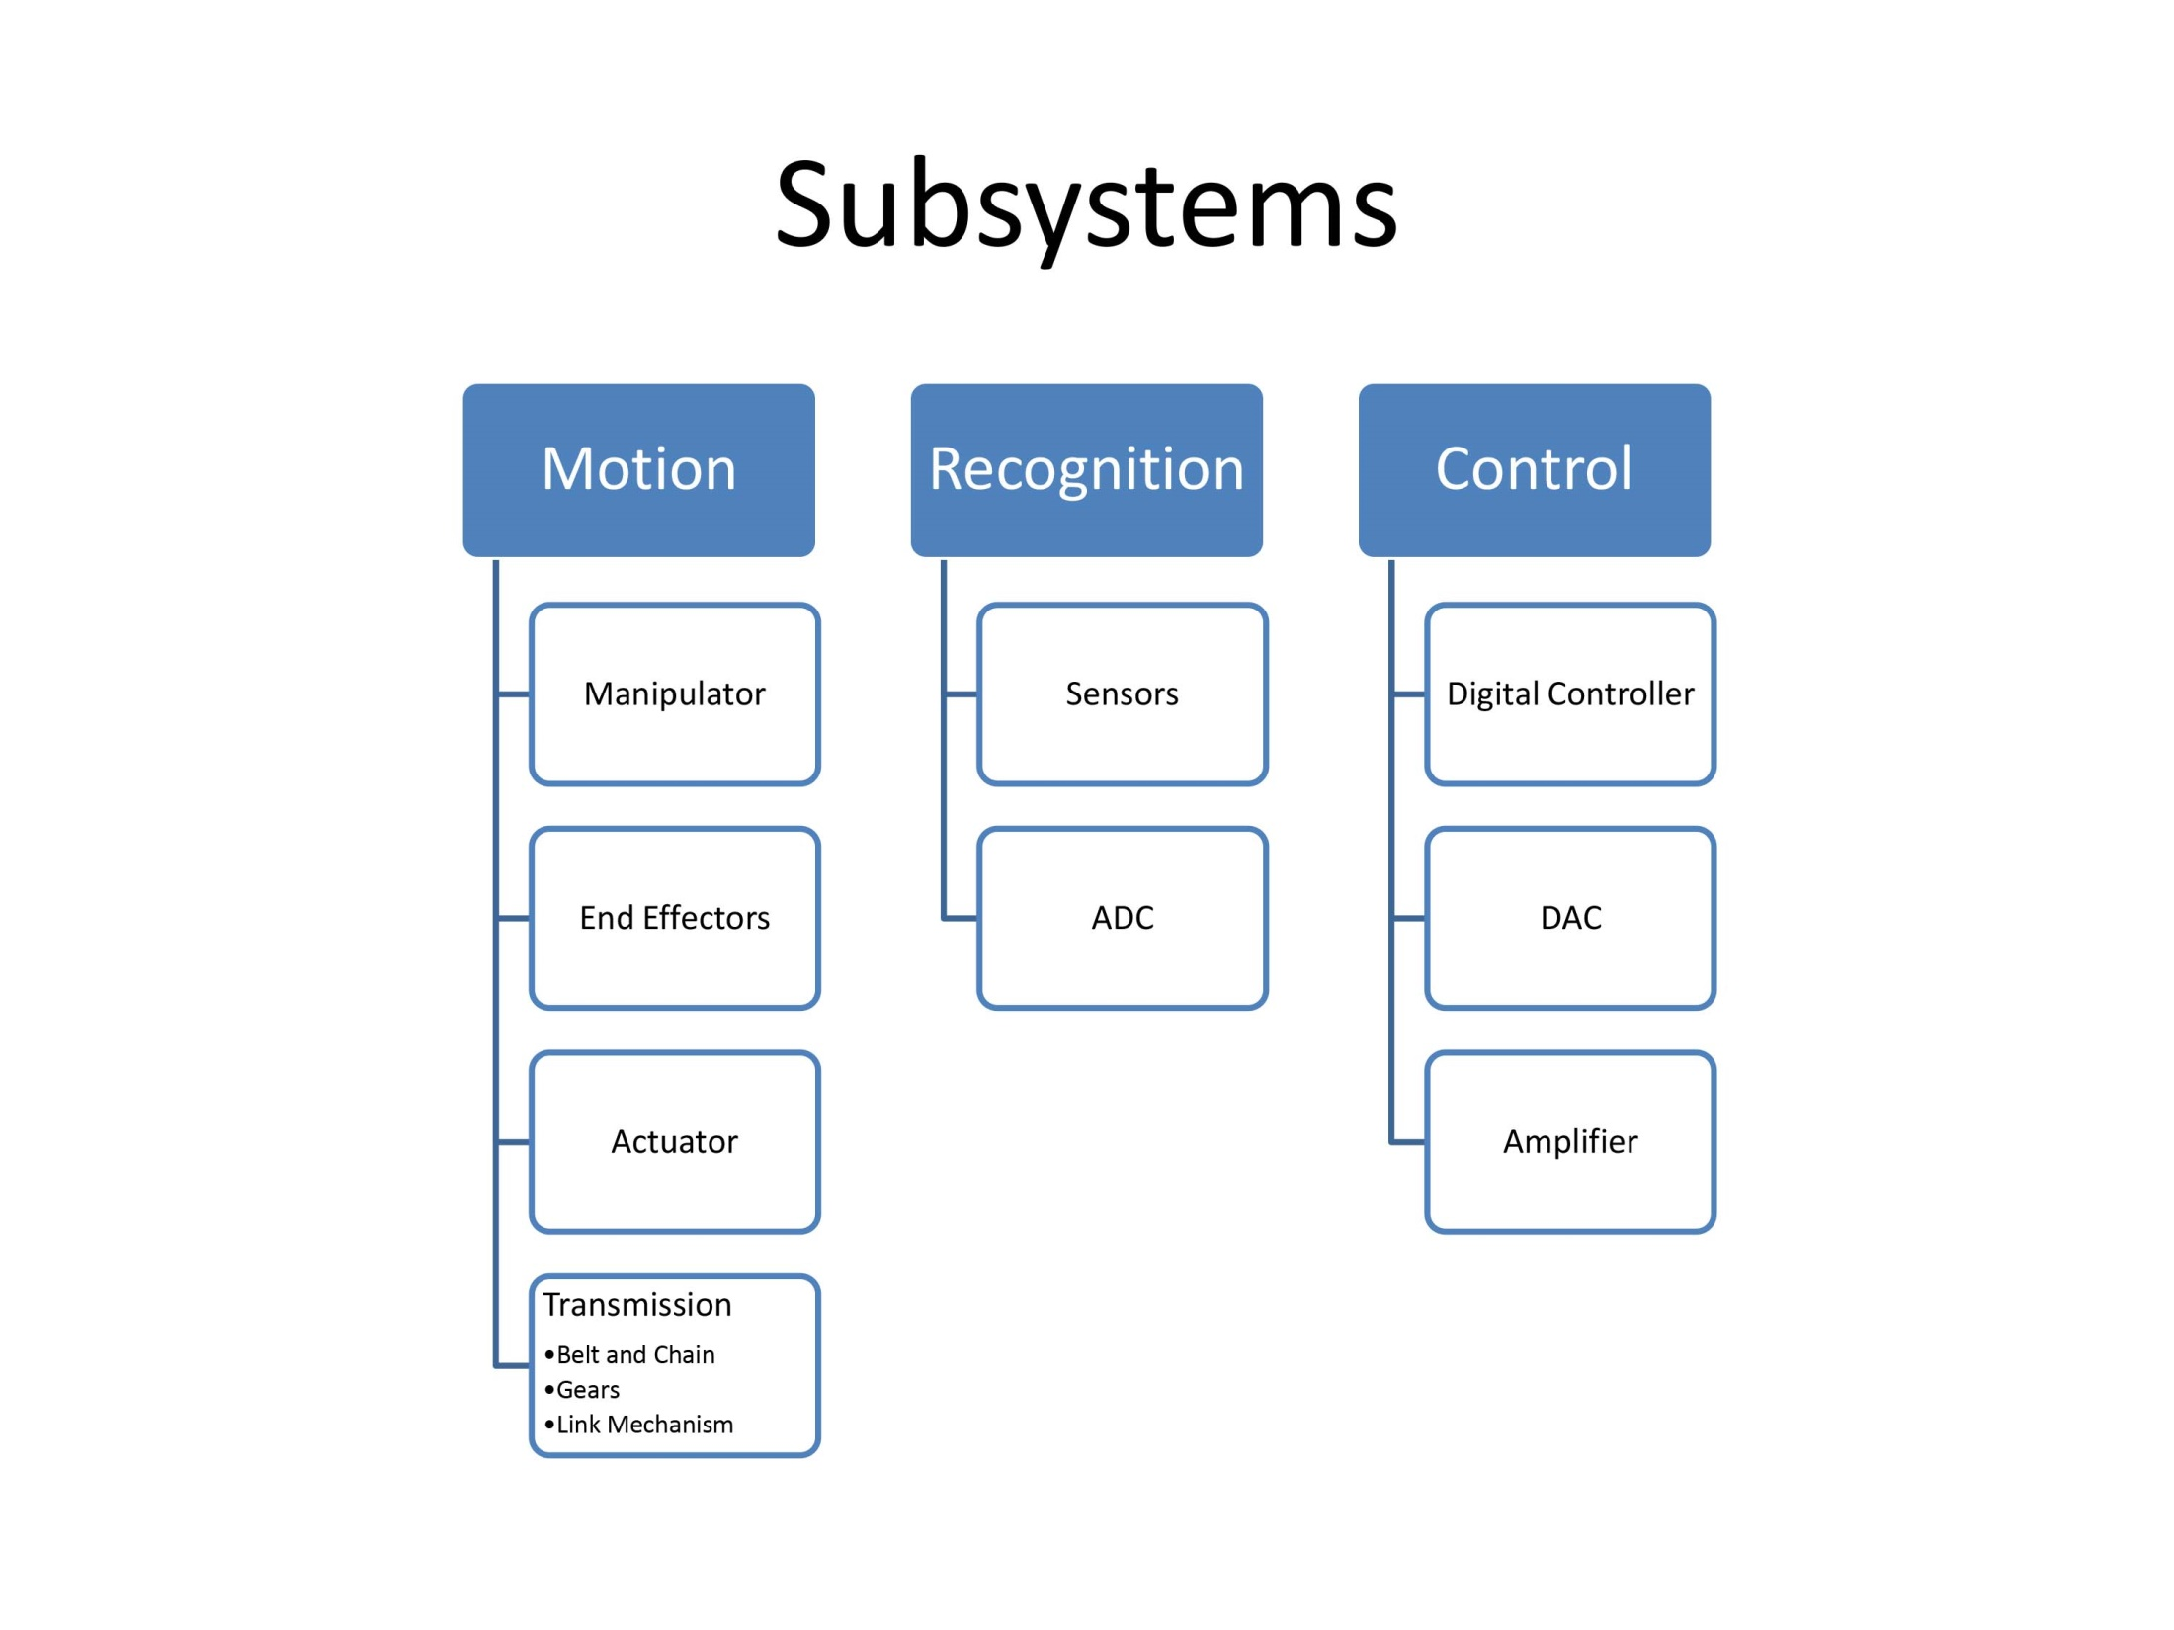

Slide 3
Motion

Slide 4
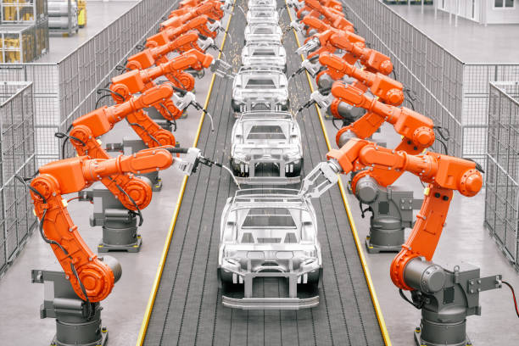

Slide 6
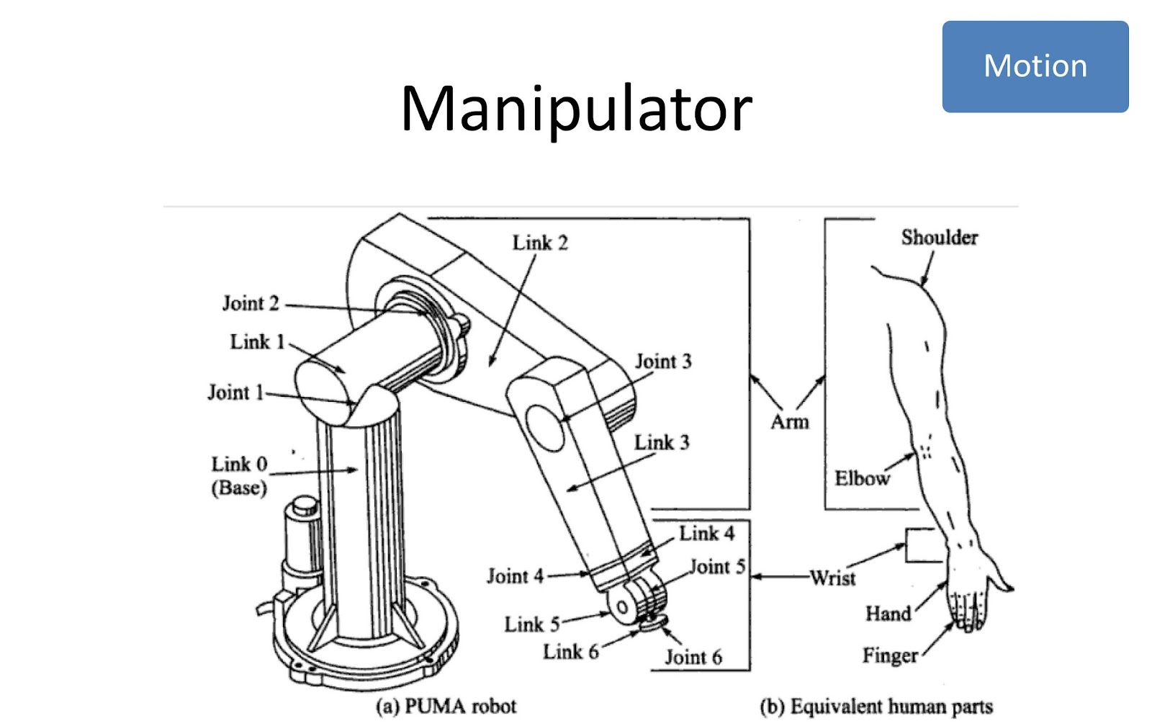

Slide 7
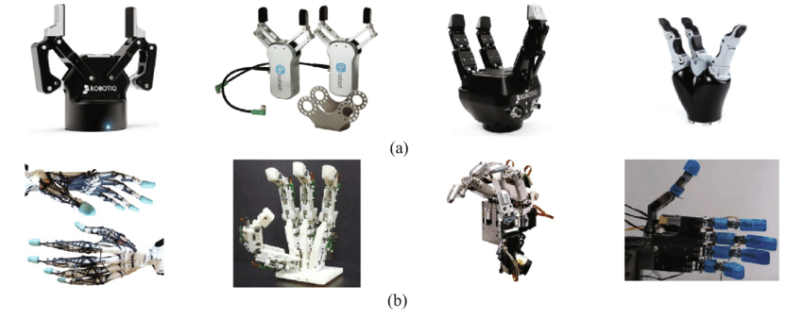

Slide 8
End Effector
Two types of fingered end-effectors: (a) gripper type, (b) anthropomorphic type

Slide 9
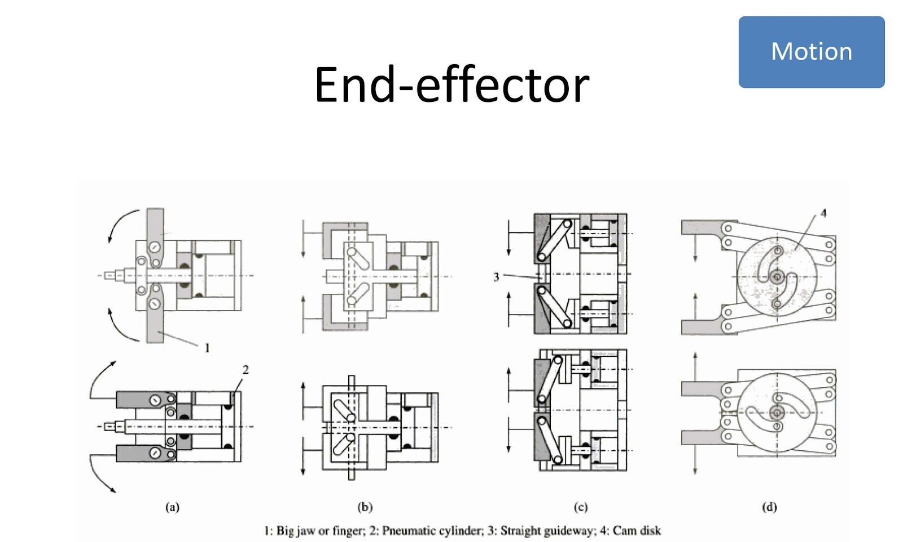

Slide 10
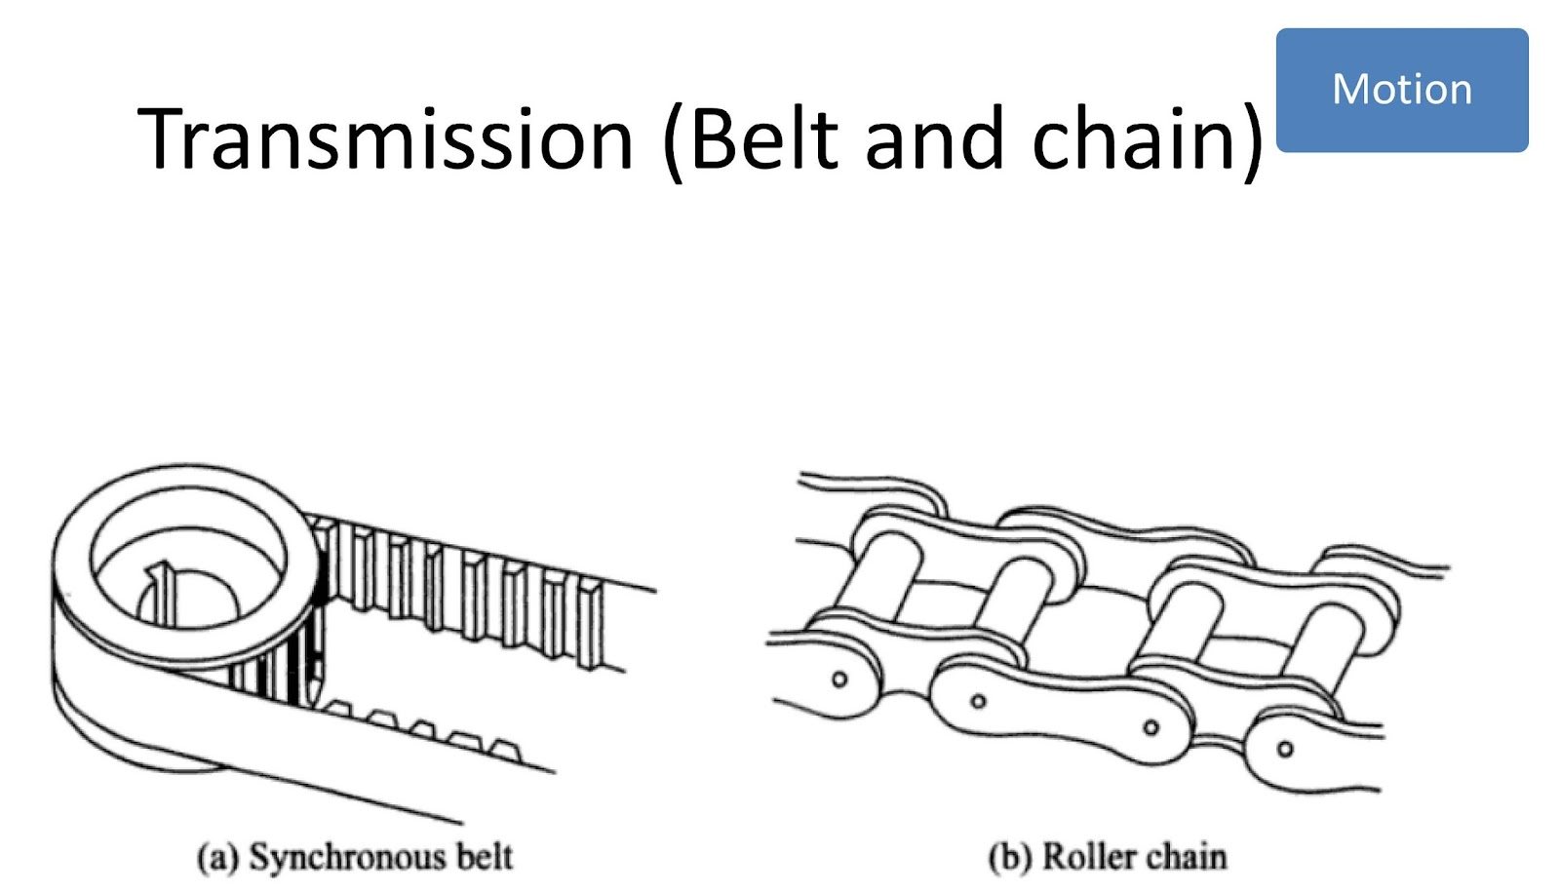

Slide 11
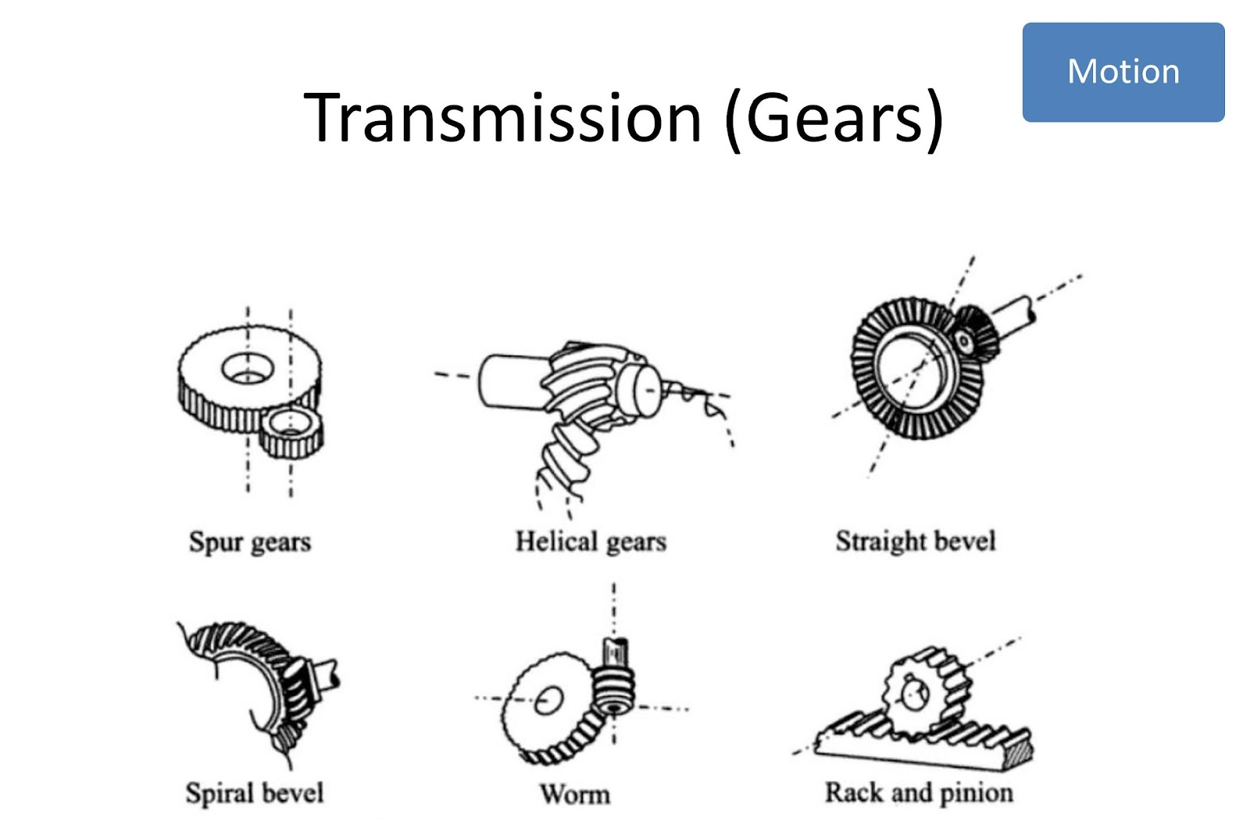

Slide 12
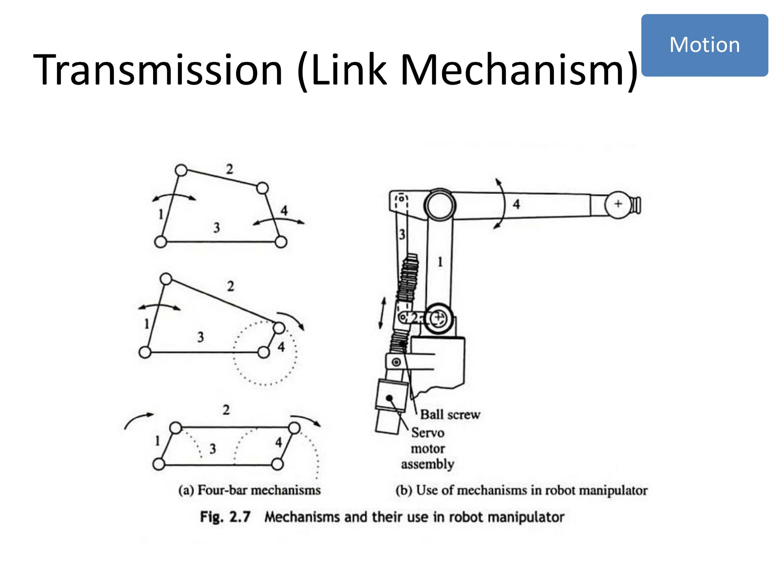

Slide 13
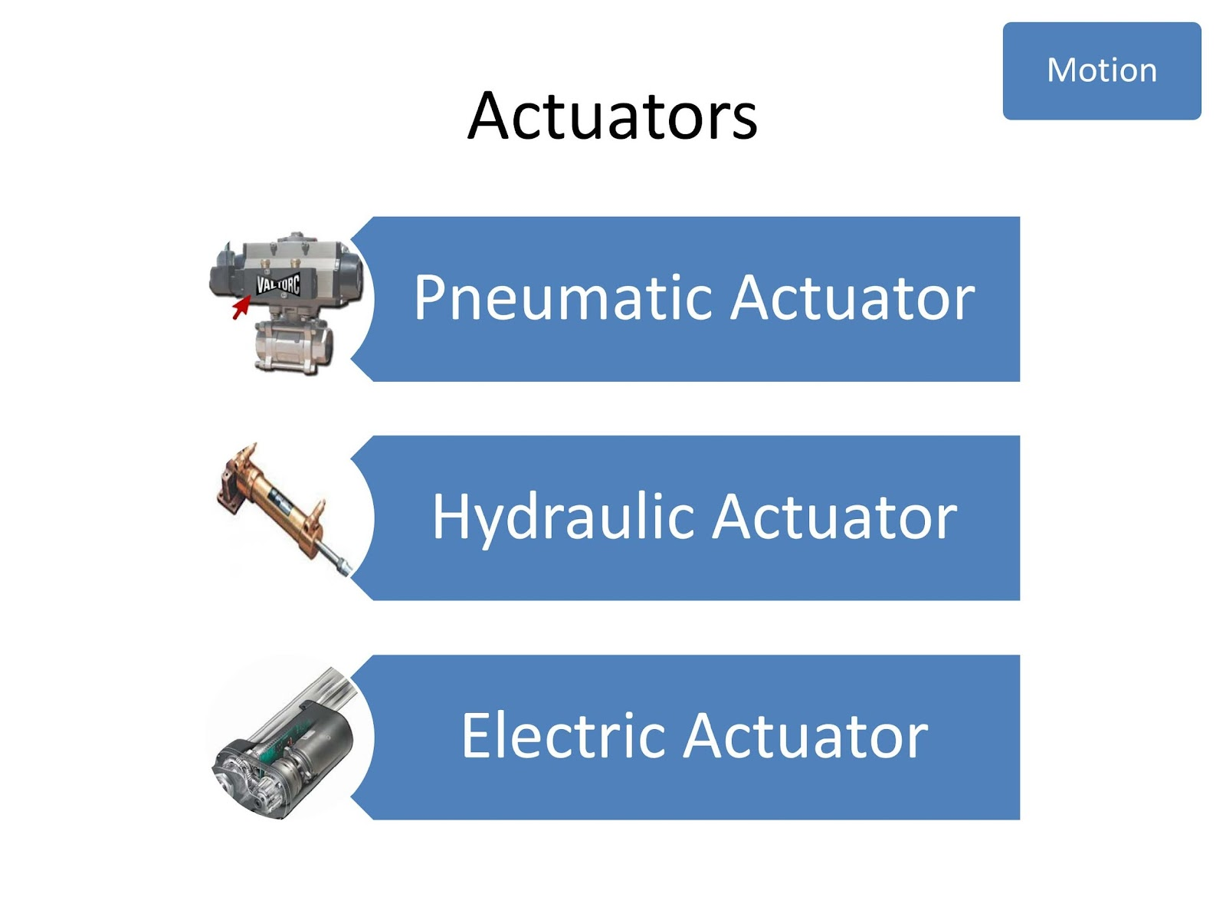

Slide 14
Pneumatic

Slide 15
Hydraulic

Slide 16
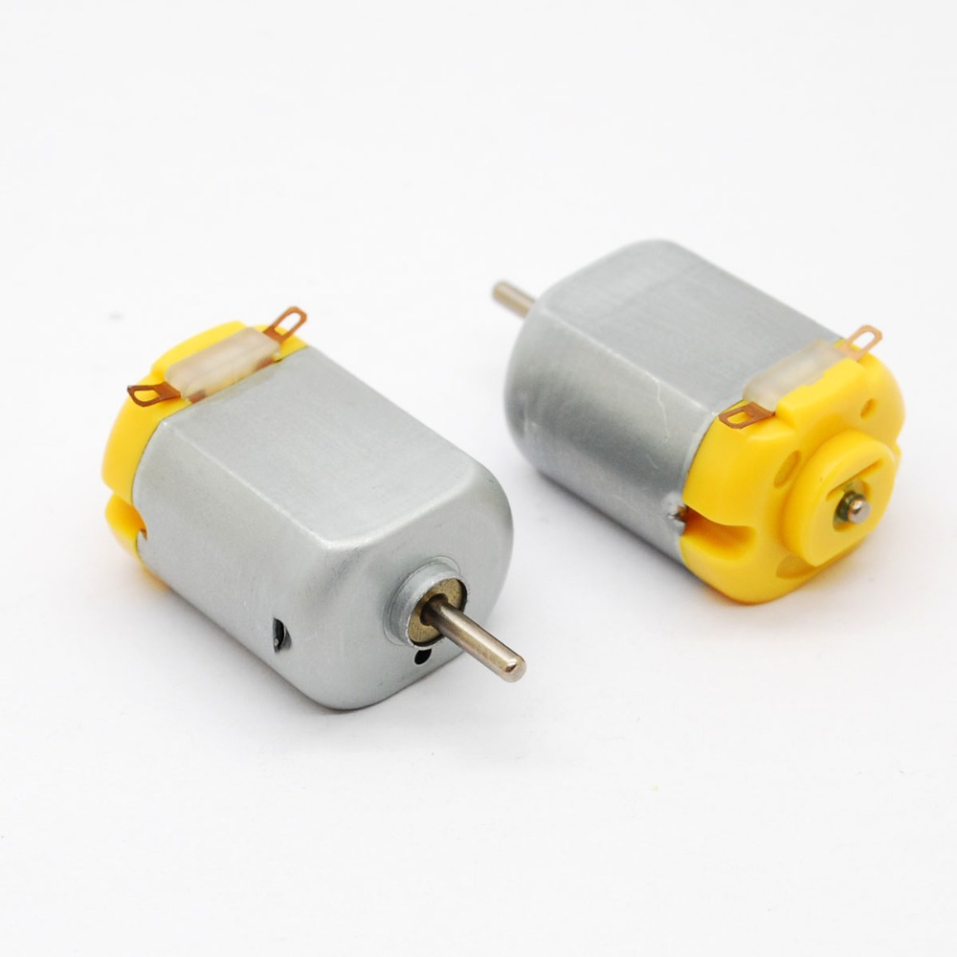
Electric

Slide 17
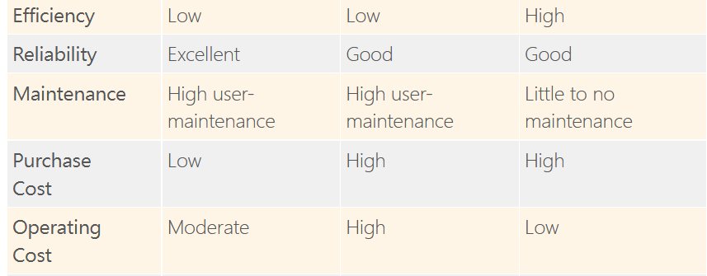

Slide 18
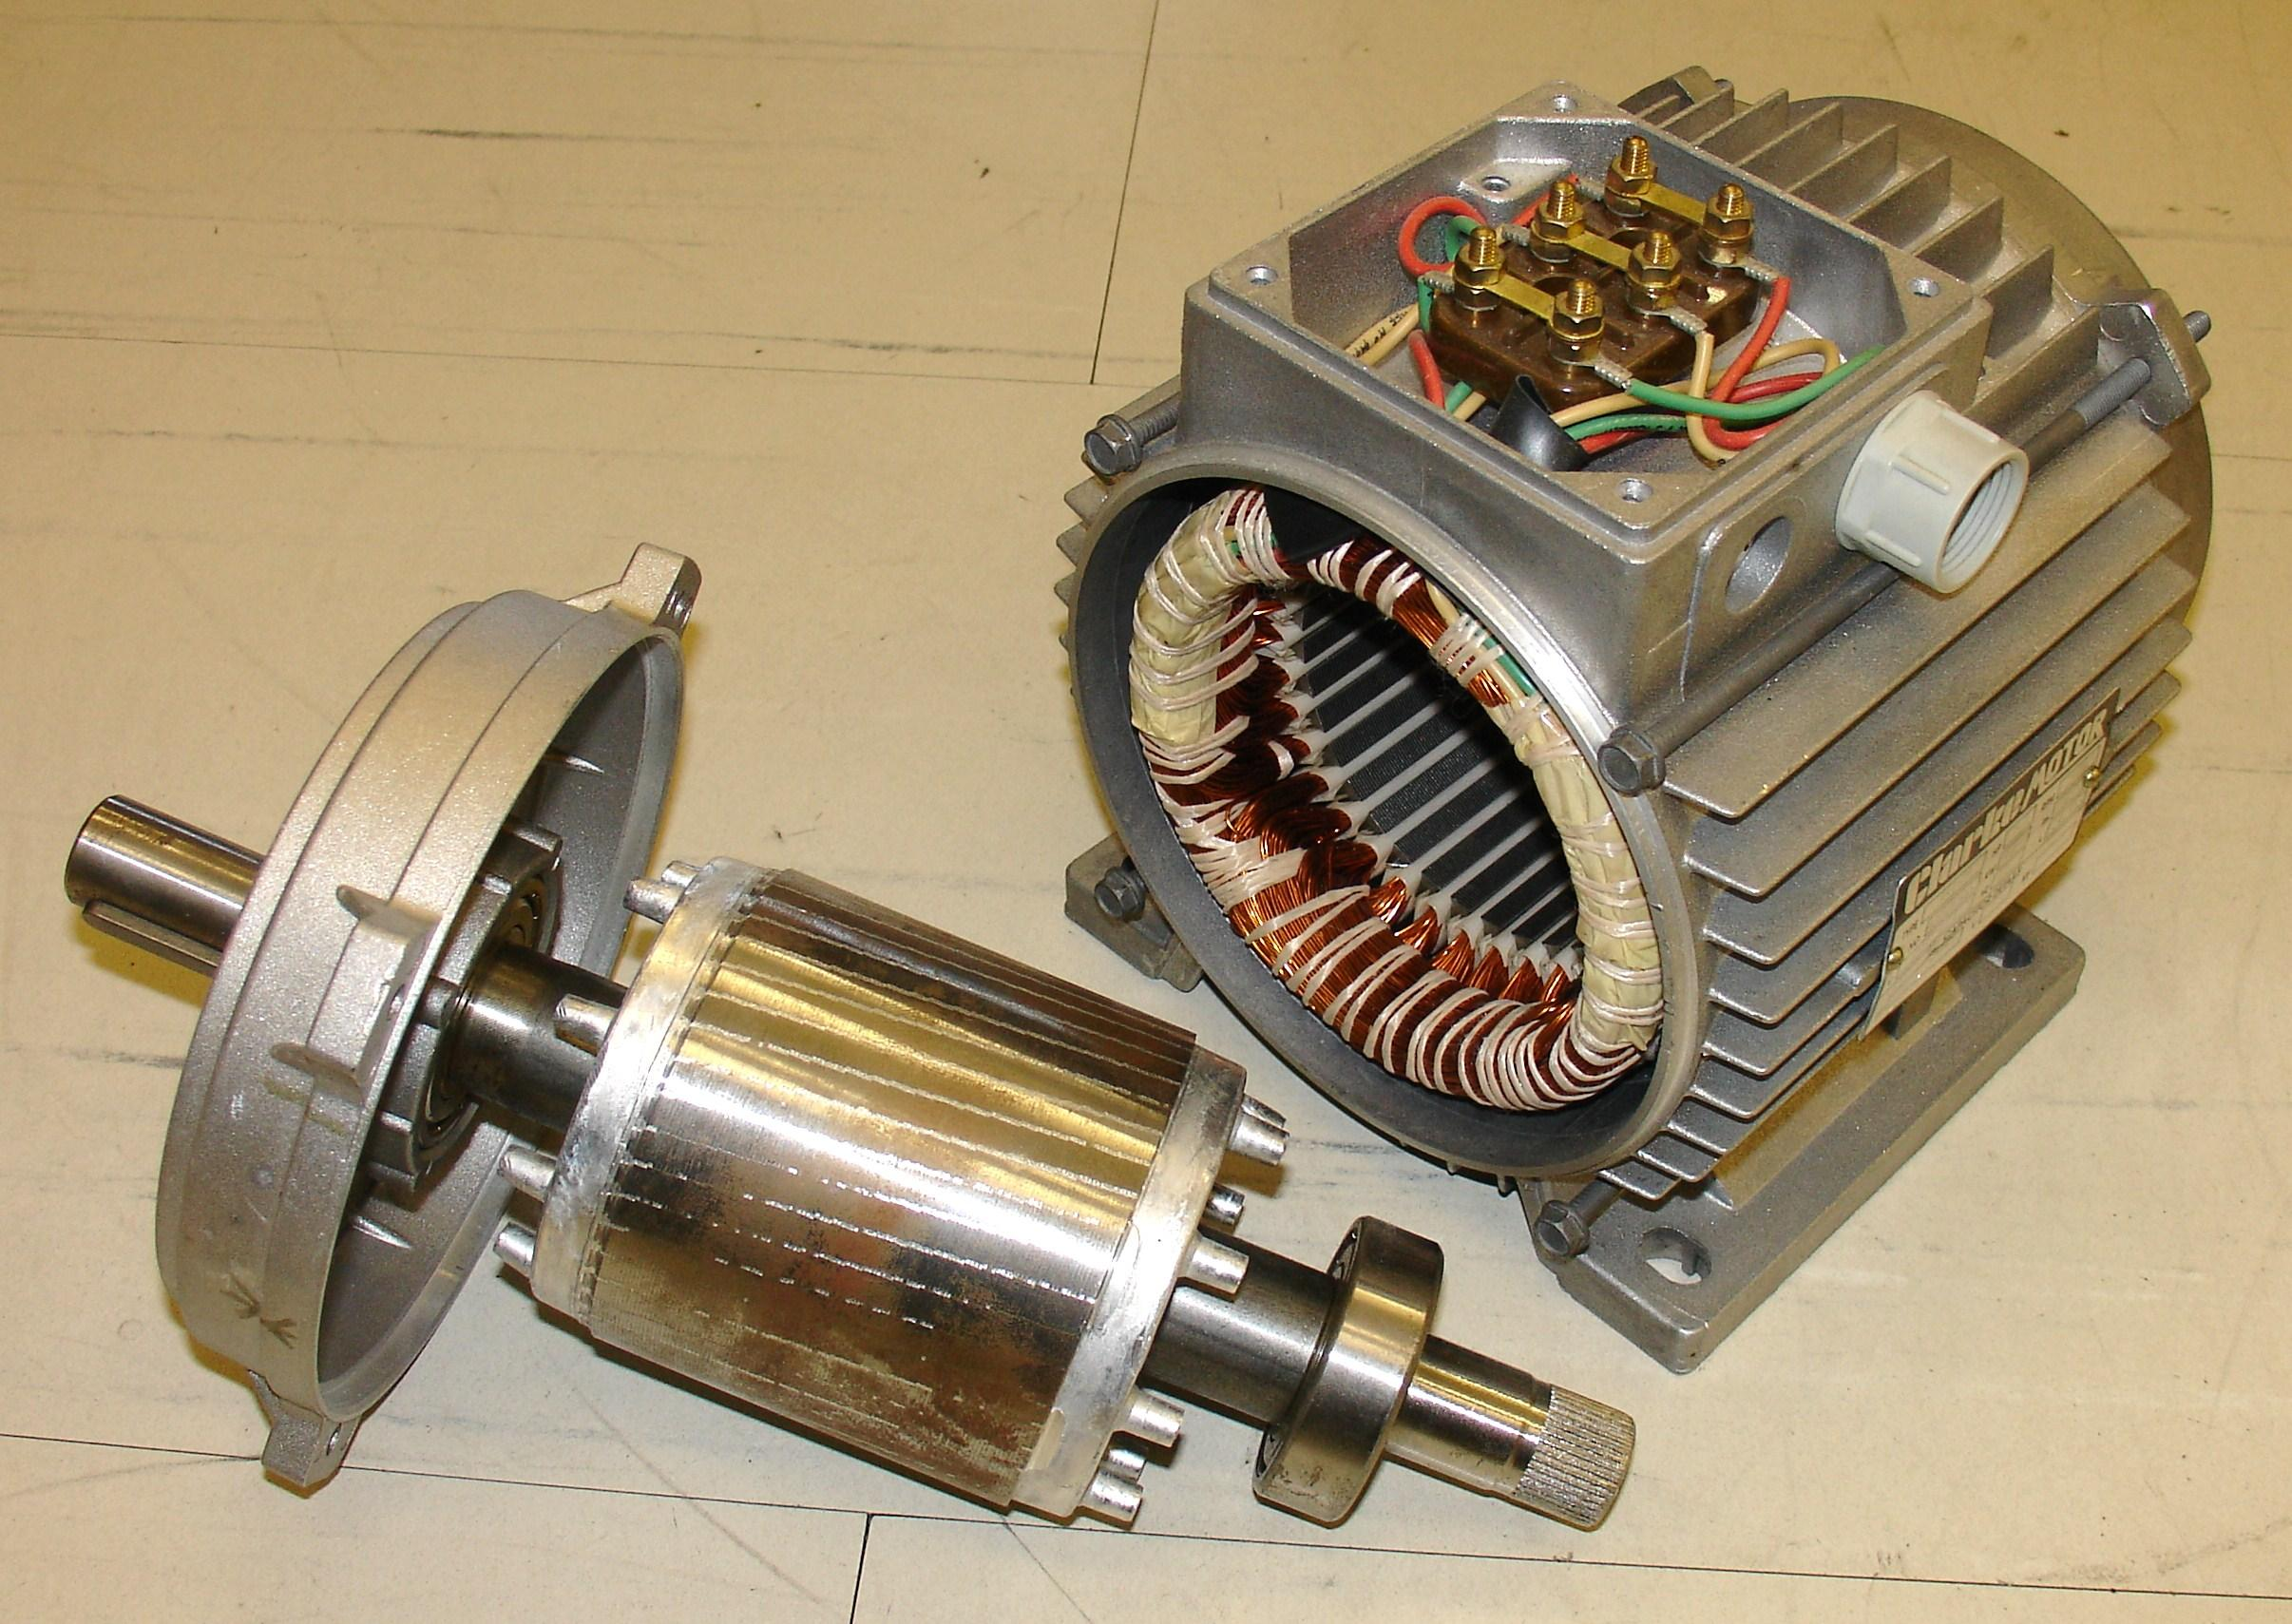
Motor
Stator
Rotor

Slide 19
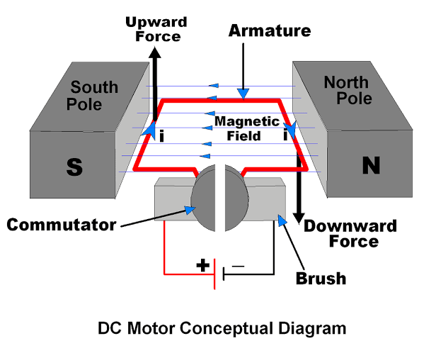
DC motor
https://youtu.be/LAtPHANEfQo

Slide 20
DC motor
https://youtu.be/LAtPHANEfQo

Slide 21
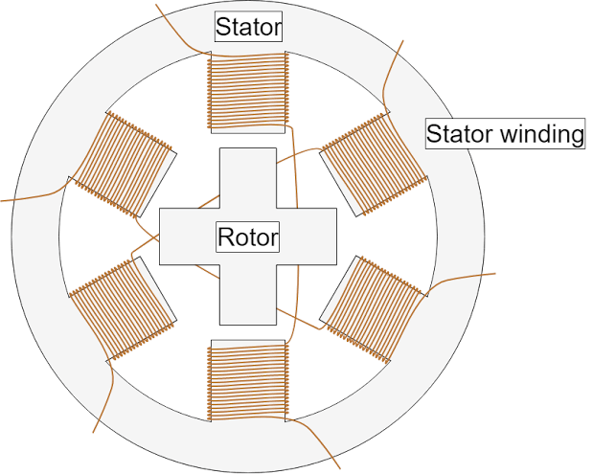
Stepper Motor
https://youtu.be/eyqwLiowZiU

Slide 22
Stepper Motor
https://youtu.be/eyqwLiowZiU

Slide 23
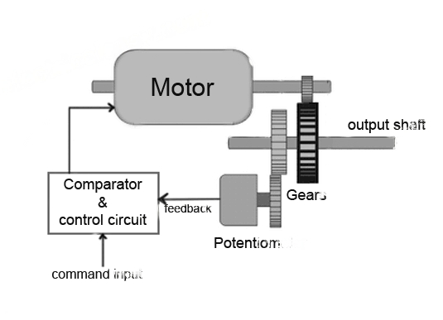
Servo Motor

Slide 24
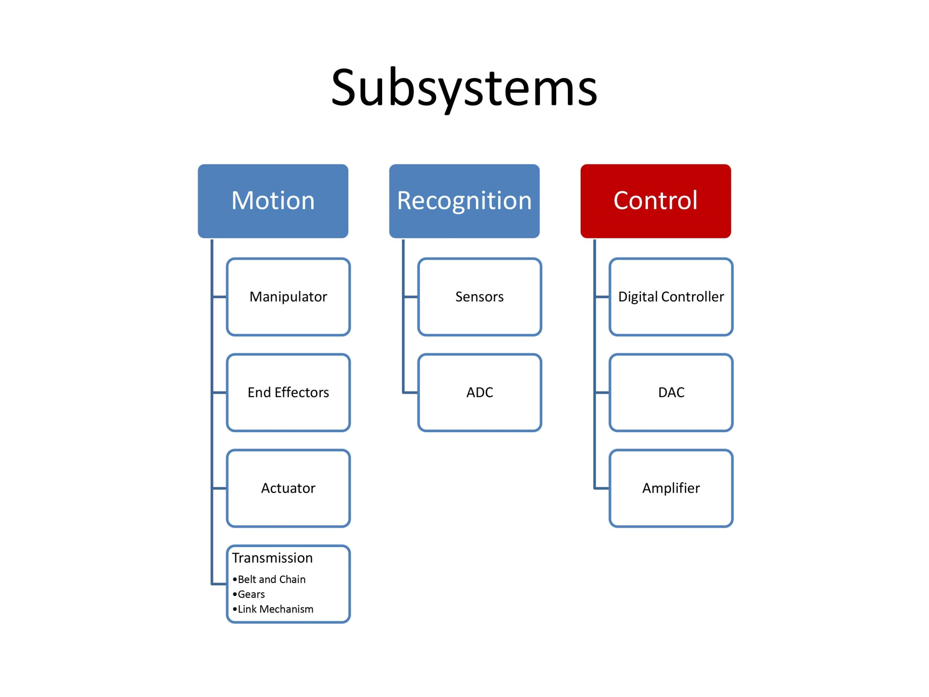

Slide 25
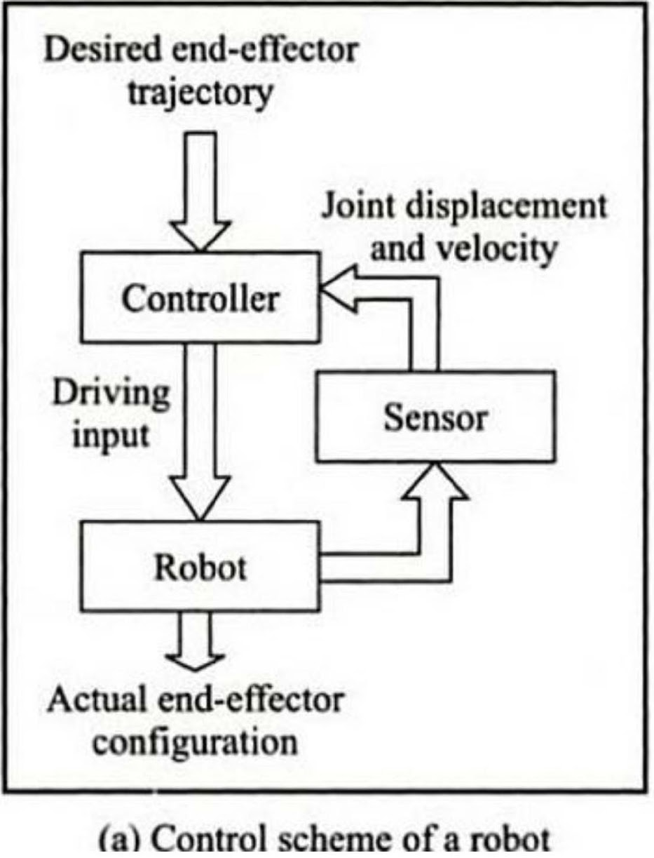
Control Software
Robot Vision
PID control
Trajectory/Motion Planning
Localization
Manipulator Control
UAV Navigation
Sensors calibration and sensor fusion
Kinematics and dynamics
Interfacing
Communication

Slide 26
Control Hardware
Microcontrollers
Arduino
PLC
FPGA
Single Board Computer
Portable PCs
Cloud Computing System

Slide 27
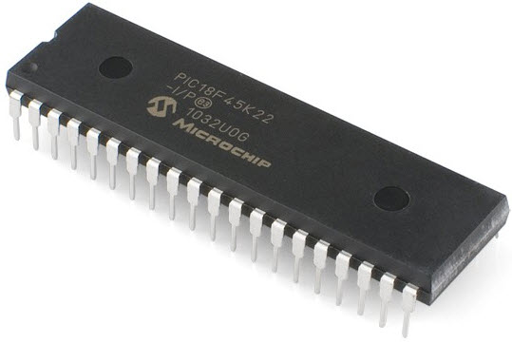
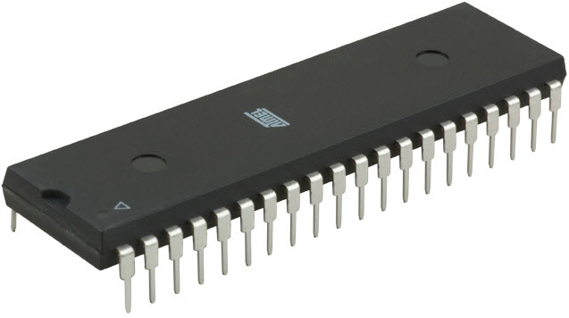
Microcontrollers
A microcontroller is a small, integrated circuit that contains a processor, memory, and input/output peripherals.

Slide 28
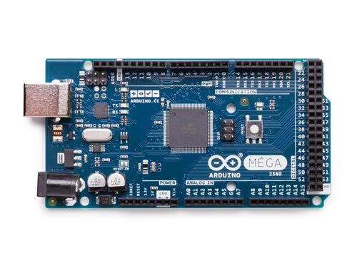

Arduino

Slide 29
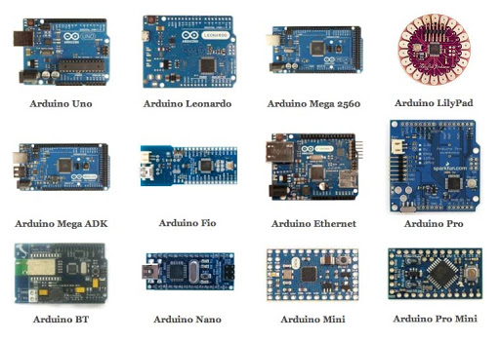
Arduino

Slide 30
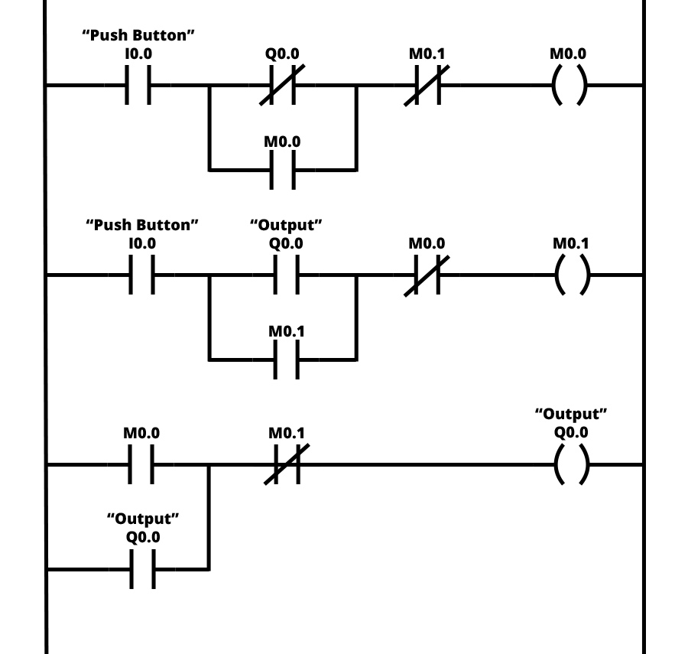
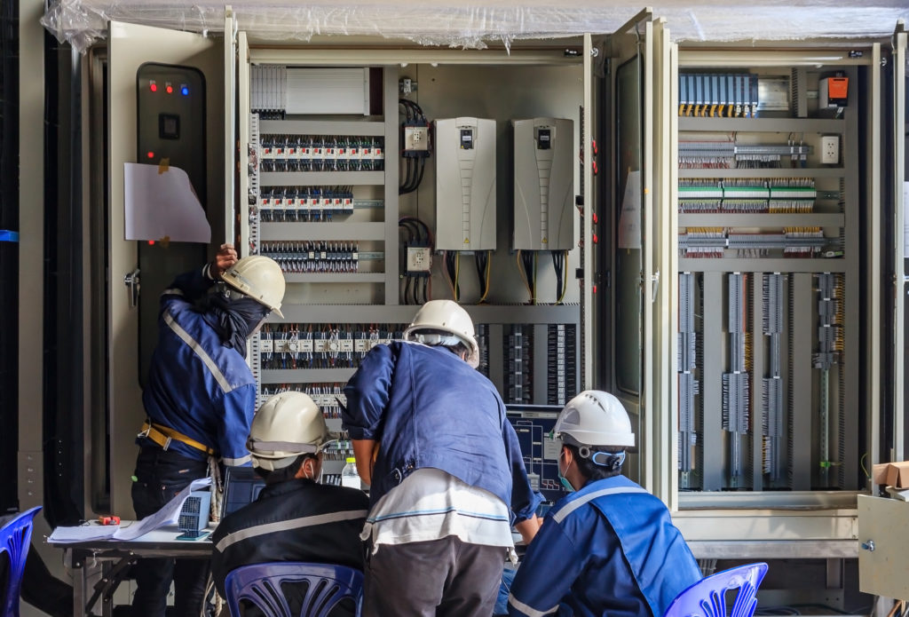
Programmable Logic Controller (PLC)

Slide 31
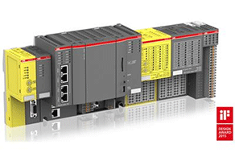
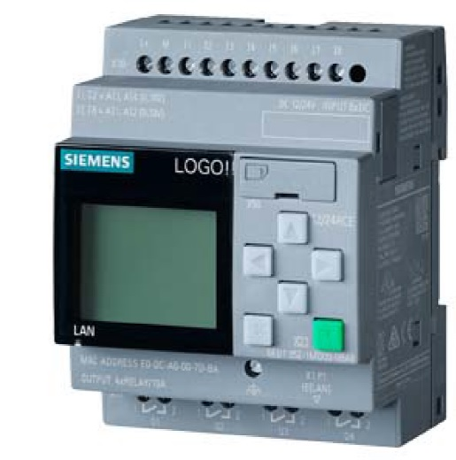
Programmable Logic Controller (PLC)

Slide 32
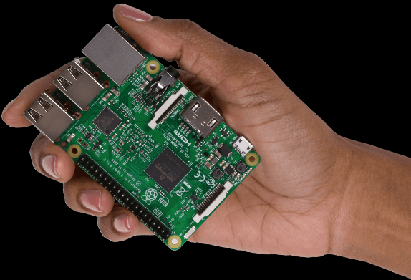
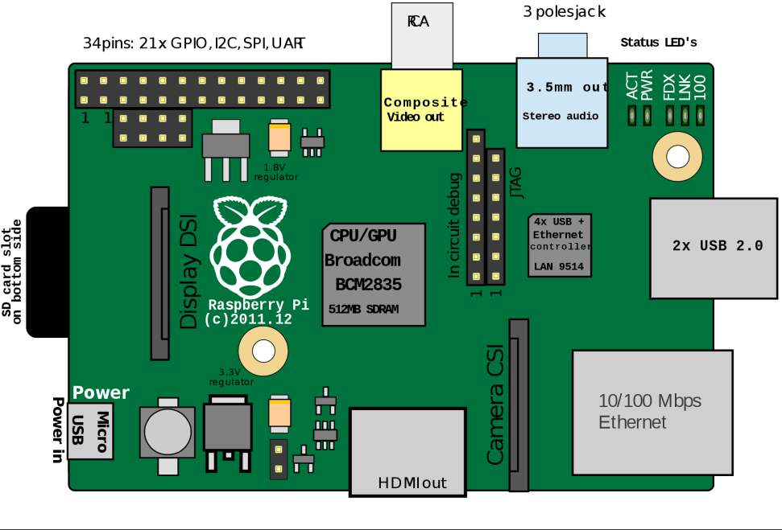
Single board Computer

Slide 33
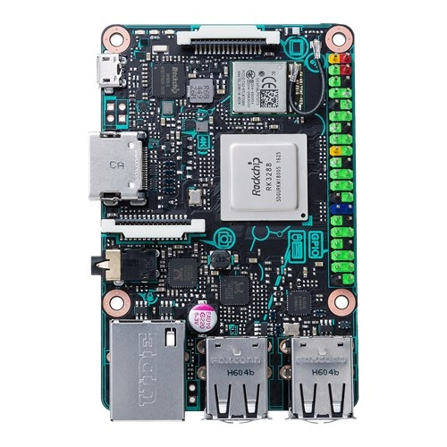
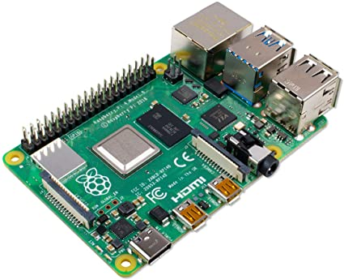
Raspberry PI 4, Tinkerboard

Slide 34
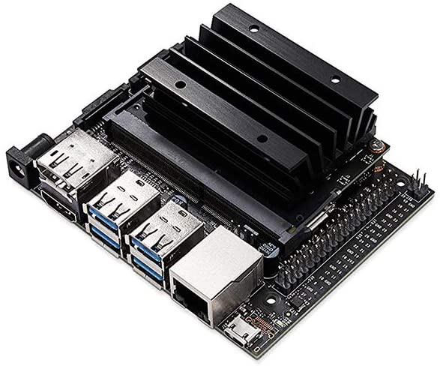
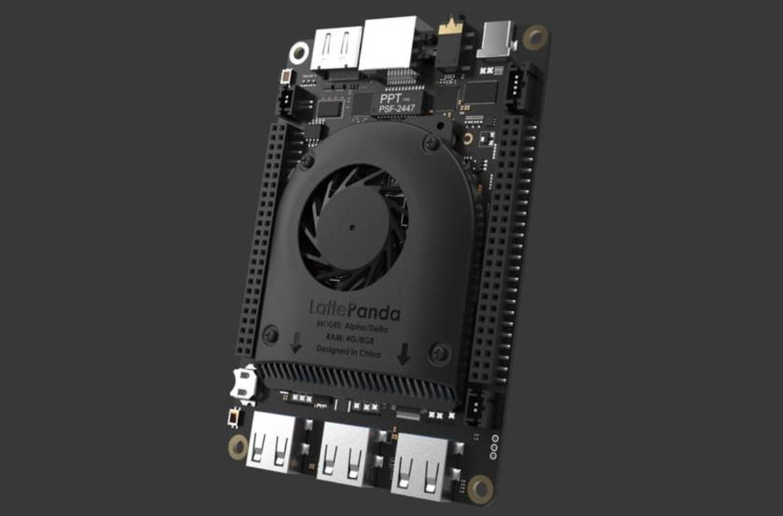
Little Panda and Jetson nano

Slide 35
Thank You

